Slide 1
Mobility to Prague
Project ,,ZSP Goniądz - Zespół Samych Profesjonalistów"
Planned dates of the training period: 22/1/2018 - 2/2/2018

Slide 2
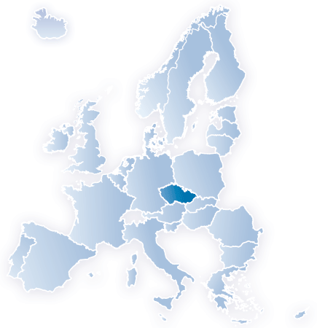
Basic facts about the Czech Republic
^{Area: 78,864 km2}
^{Population: 10,266,000}
^{Official language: Czech}
^{Head of State: President}
^{State system: republic}
Language: Czech 94,9%, slovak 2%
^{Religion: Roman-Catholic (27%)} ^{atheist (59%)}
^{Currency: Czech crown (CZK)}
^{Capital: Prague}

Slide 3
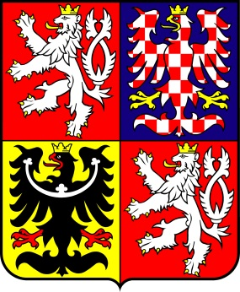
Basic facts about the Czech Republic
Flag of the Czech Republic Czech State Emblem

Slide 4
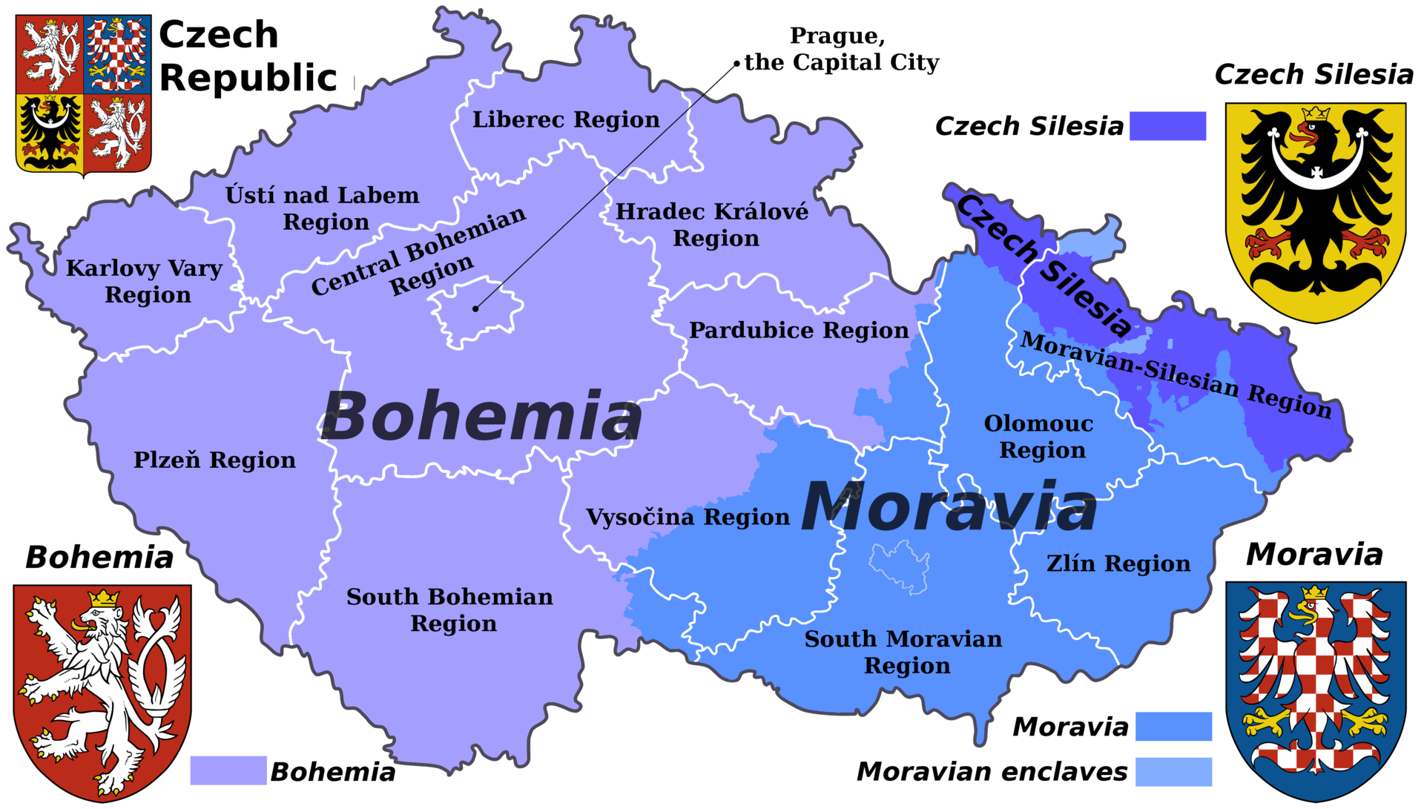
Basic facts about the Czech Republic

Slide 5
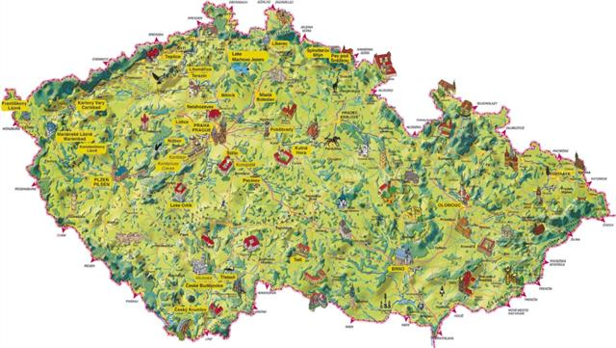
273 km
493 km

Slide 6
Ostrava
Prague
Olomouc
Plzeň (Pilsen)
Brno
Český Krumlov

Slide 7
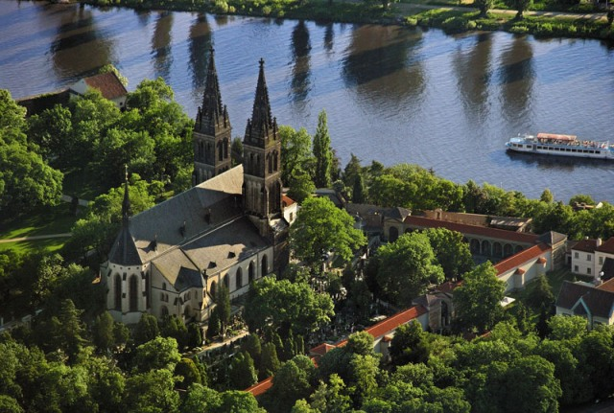
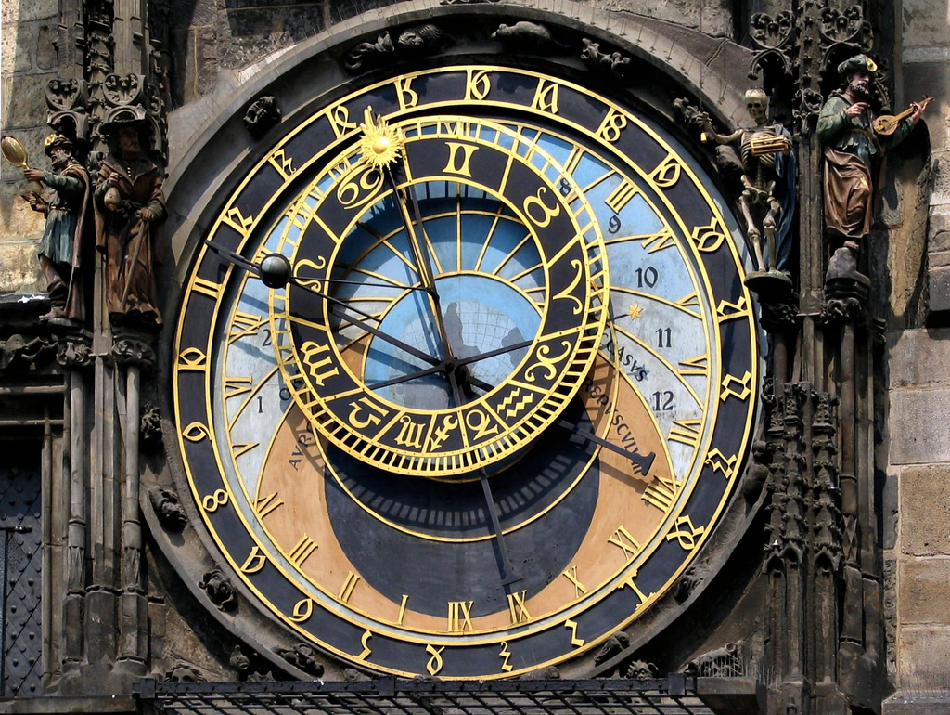
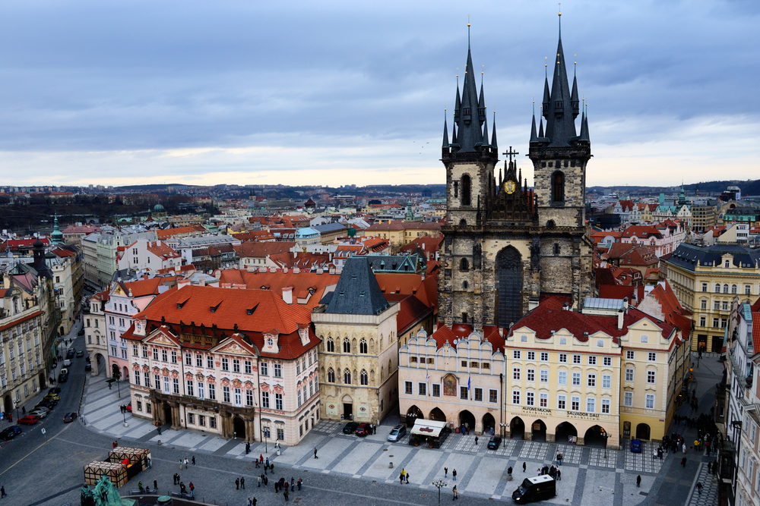
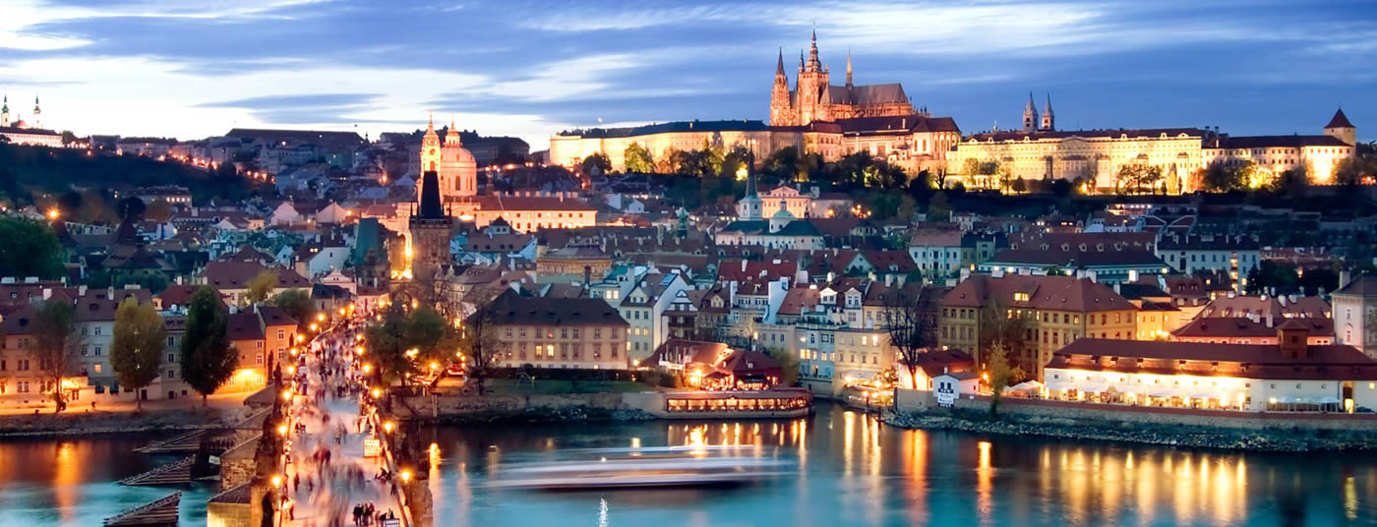
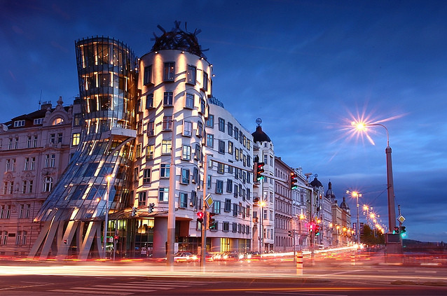
Prague

Slide 8
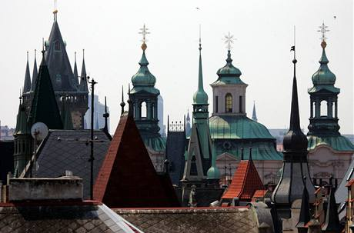
Prague
Capital of the Czech Republic
Largest city of CZ
14th largest city of EU
1,4 million inhabitans
4 millions tourists every year
Prague is the fifth most visited European city after London, Paris, Istanbul and Rome
Settled in 9th century
All architectural styles
Called „hundred-spired“ Prague – 100 towers
8

Slide 9
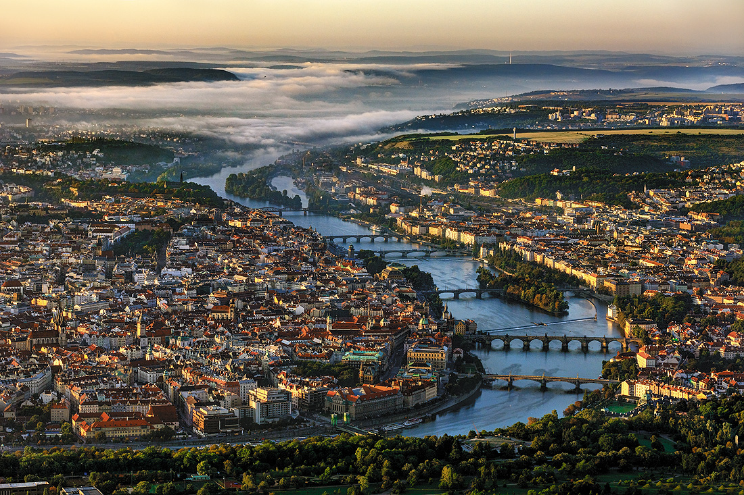
Prague - geography
On the Vltava river
Situated in the north-west of the country

Slide 10
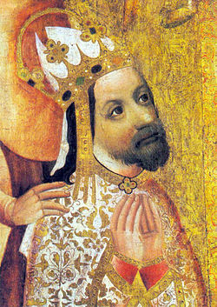
Prague - history
political, cultural and economic centre of central Europe complete with a rich history
Founded during the Romanesque and flourishing by the Gothic, Renaissance and Baroque era
the capital of the kingdom of Bohemia
the main residence of several Holy Roman Emperors, most notably of (r. 1346–1378) Charles IV
It was an important city to the Habsburg Monarchy and its Austro-Hungarian Empire
The city played major roles in the Bohemian and Protestant Reformation, the Thirty Years' War and in 20th-century history as the capital of Czechoslovakia, during both World Wars and the post-war Communist era

Slide 11
Prague - tourism
Prague is home to a number of famous cultural attractions, many of which survived the violence and destruction of 20th-century Europe
Main attractions include the Prague Castle, the Charles Bridge, Old Town Square with the Prague astronomical clock, the Jewish Quarter, Petřín hill and Vyšehrad.
Since 1992, the extensive historic centre of Prague has been included in the UNESCO list of World Heritage Sites
The city has more than ten major museums, along with numerous theatres, galleries, cinemas and other historical exhibits

Slide 12
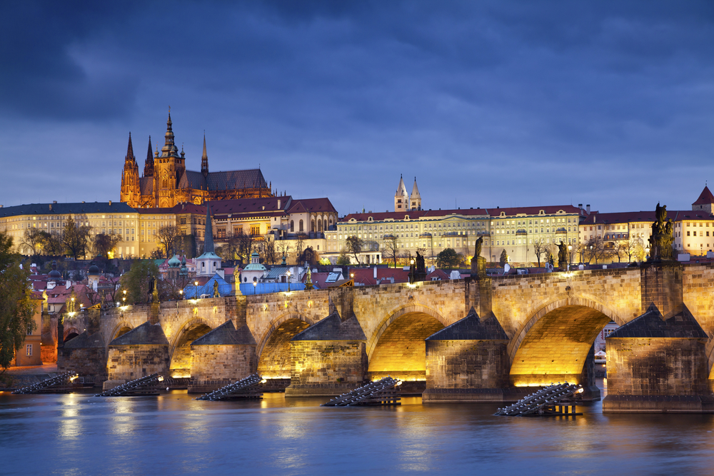
Prague Castle

Slide 13
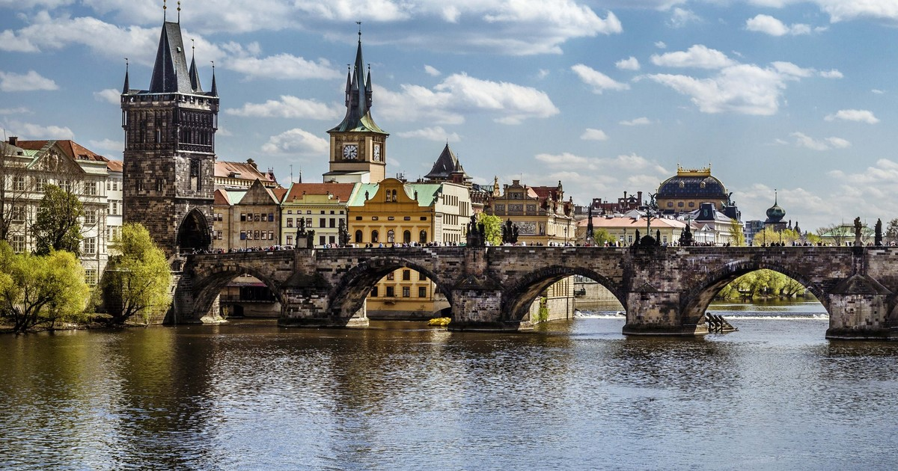
Charles Bridge

Slide 14
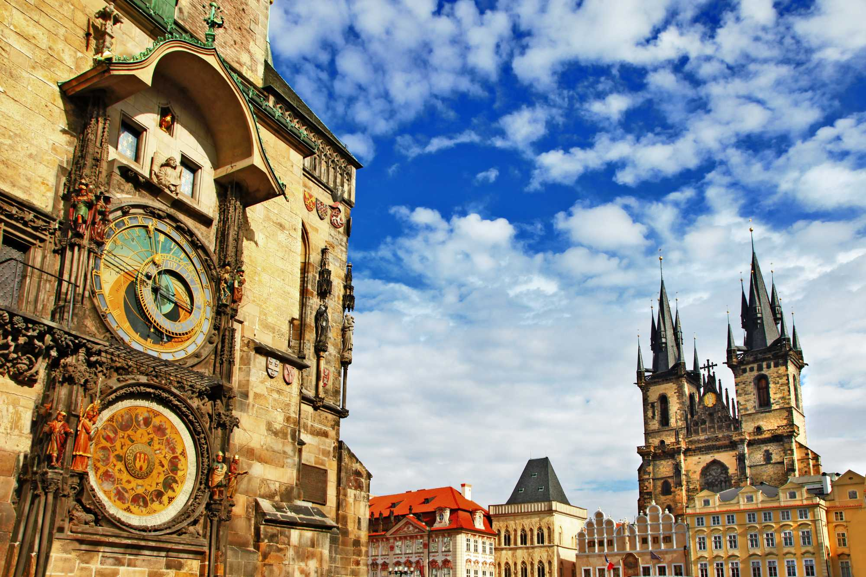
Old Town Square with the Prague astronomical clock

Slide 15
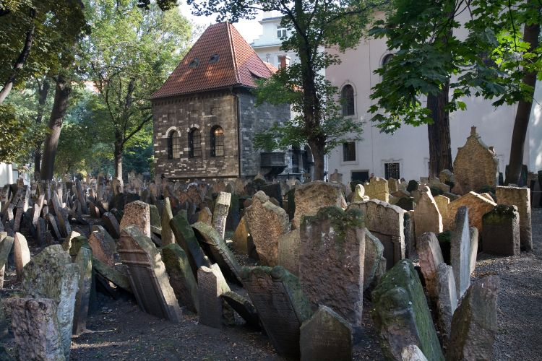
Jewish Quarter

Slide 16
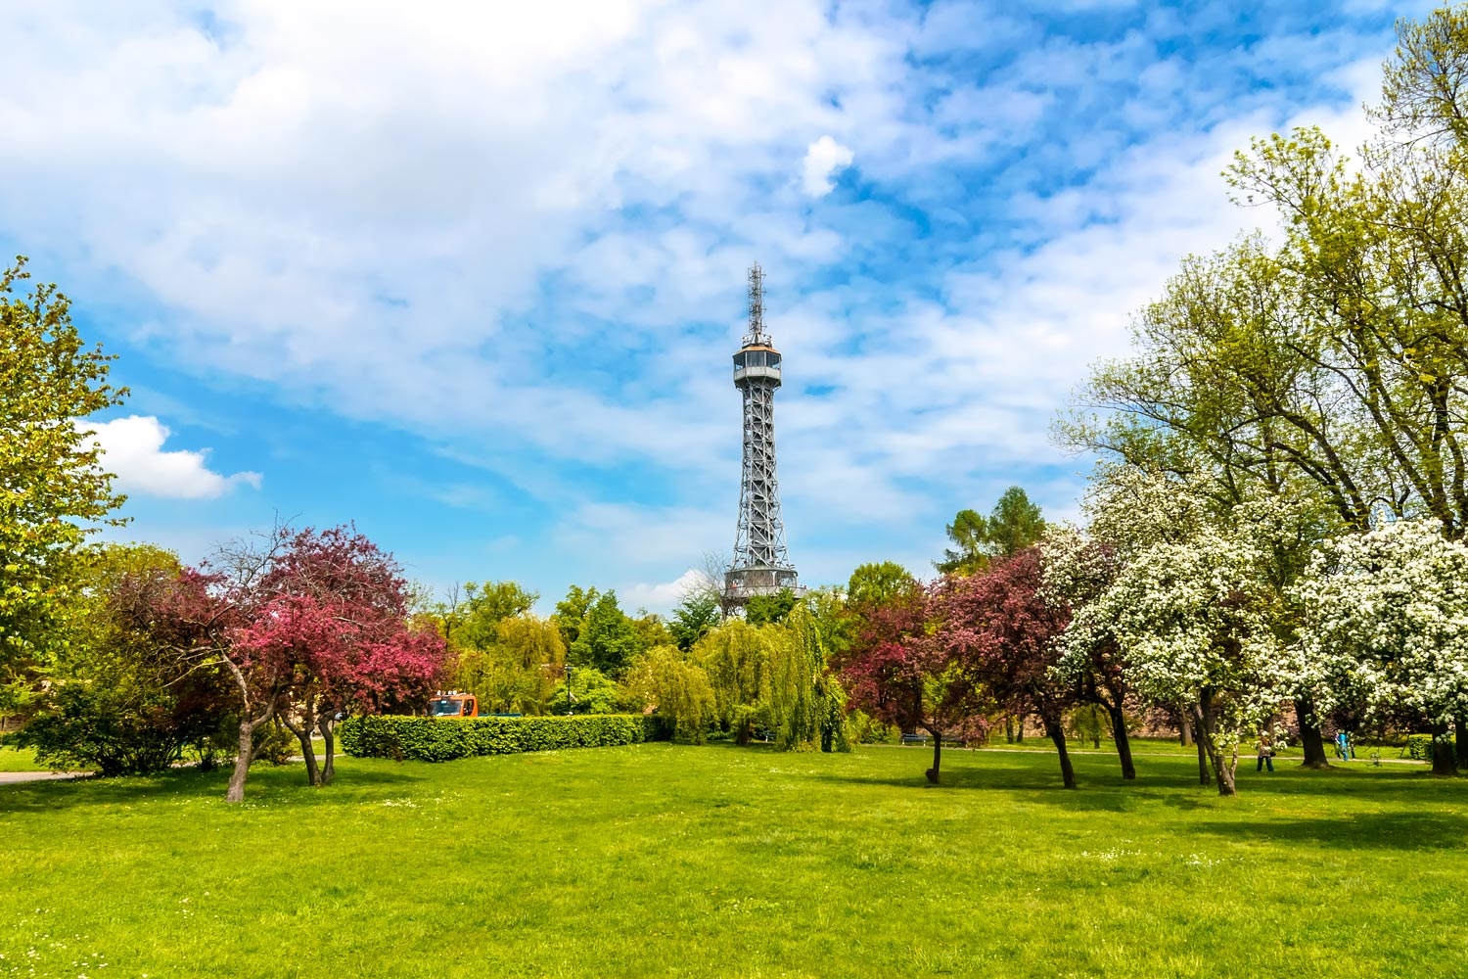
Petřín Hill

Slide 17
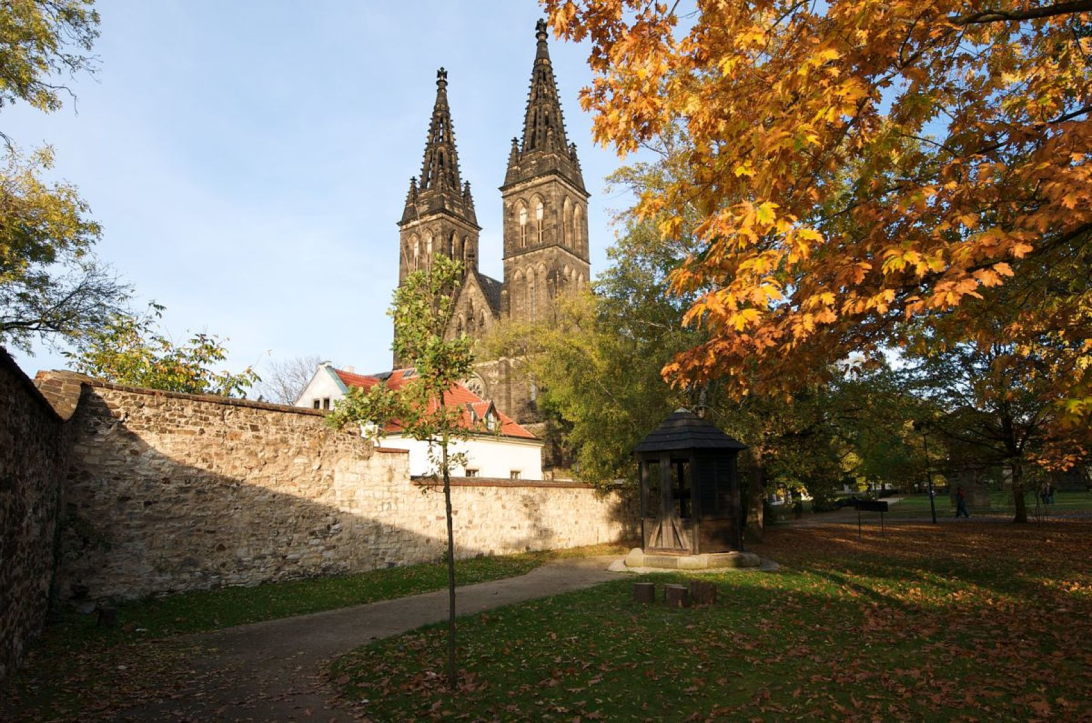
Vyšehrad

Slide 18
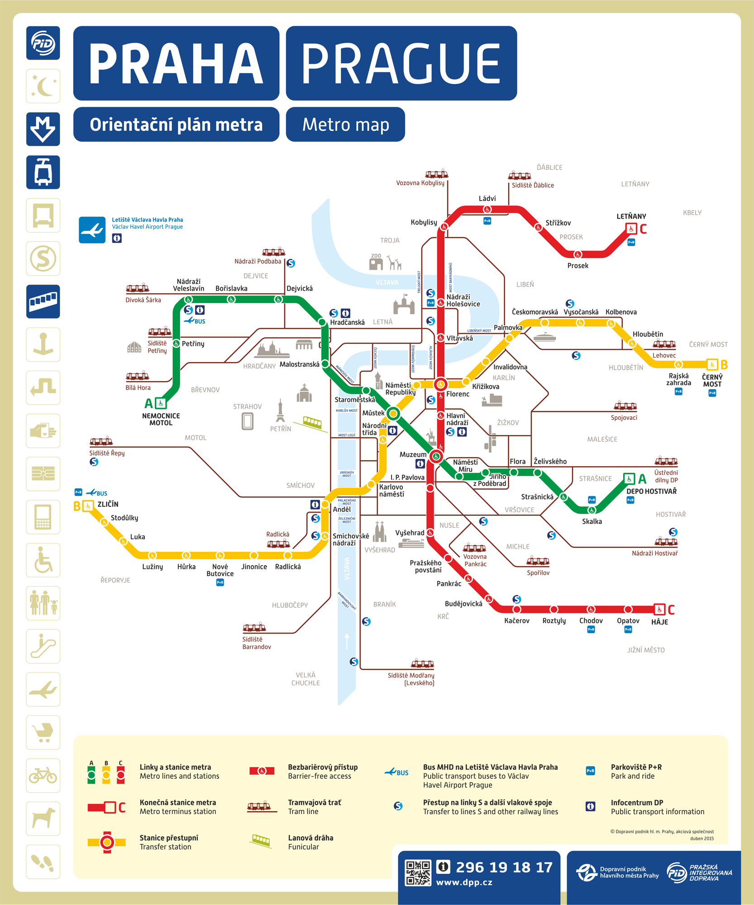
Prague – public transport
An extensive modern public transportation system connects the city
3 metro lines

Slide 19
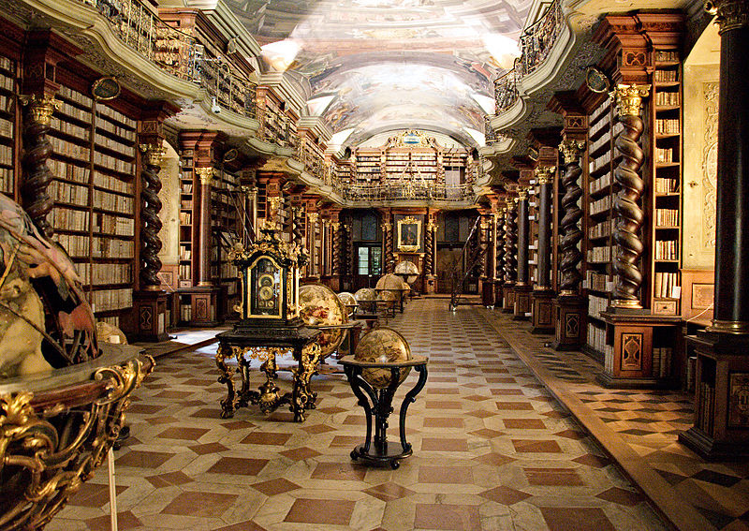
Prague - education
it is home to a wide range of public and private schools, including Charles University in Prague, the oldest university in Central Europe

Slide 20
Schools to be visited by teachers from Goniadz

Slide 21
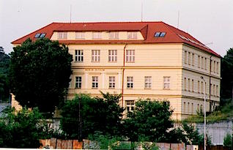
Elementary School K Dolům
http://www.zskdolum.cz/
The Elementary School K Dolům claims to be based on individual approach towards its students in favor of making them feel welcome and healthy.
The school puts a special emphasis on teaching manners and ethics.
This elementary school encourages its students to become more educated in terms of ICT and by doing so it overruns the majority of the Czech elementary schools.

Slide 22
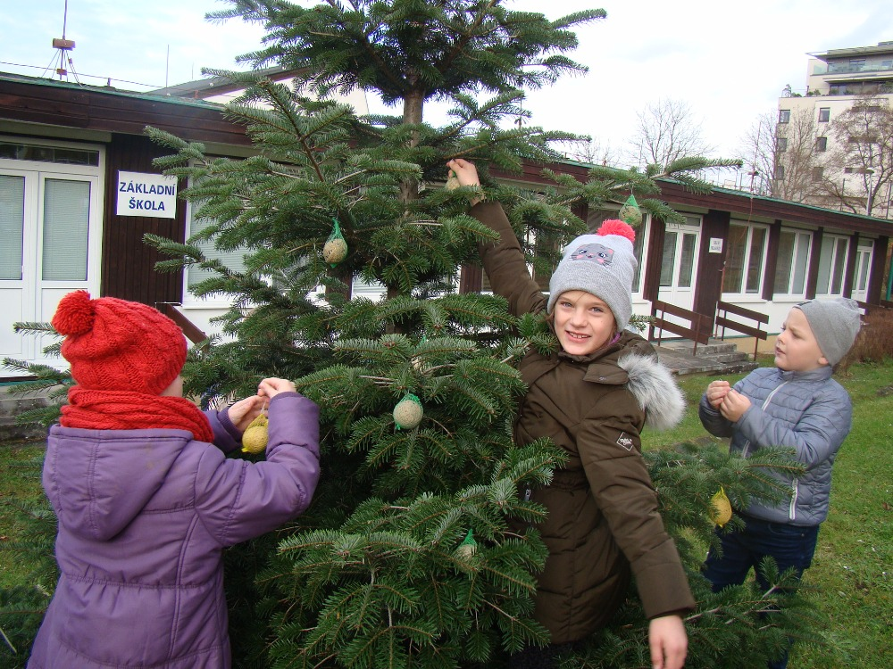
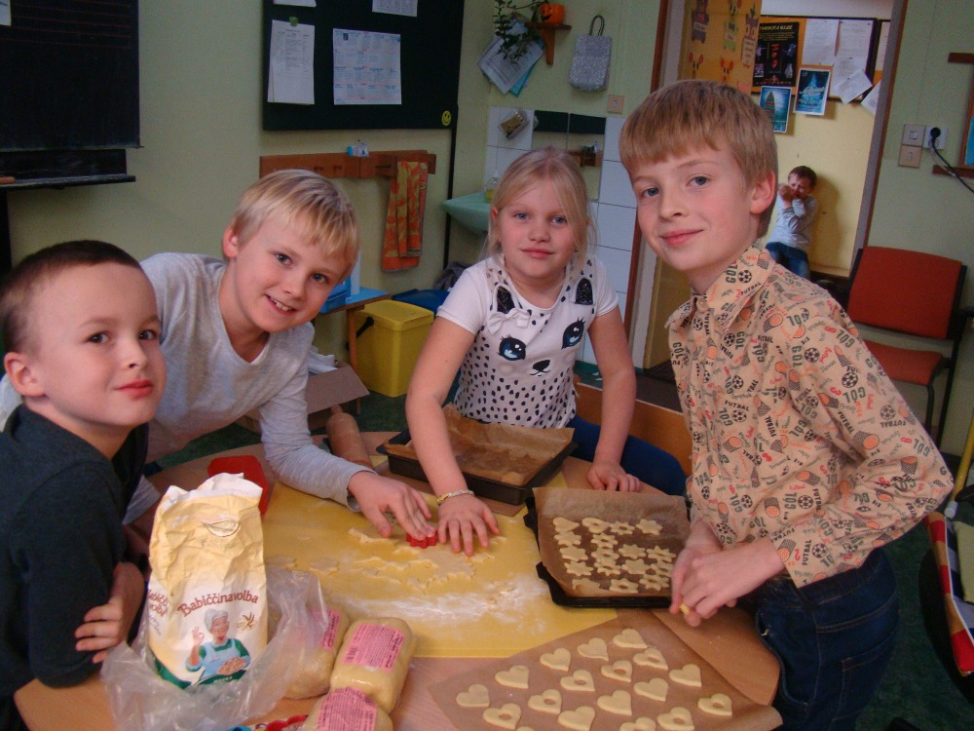
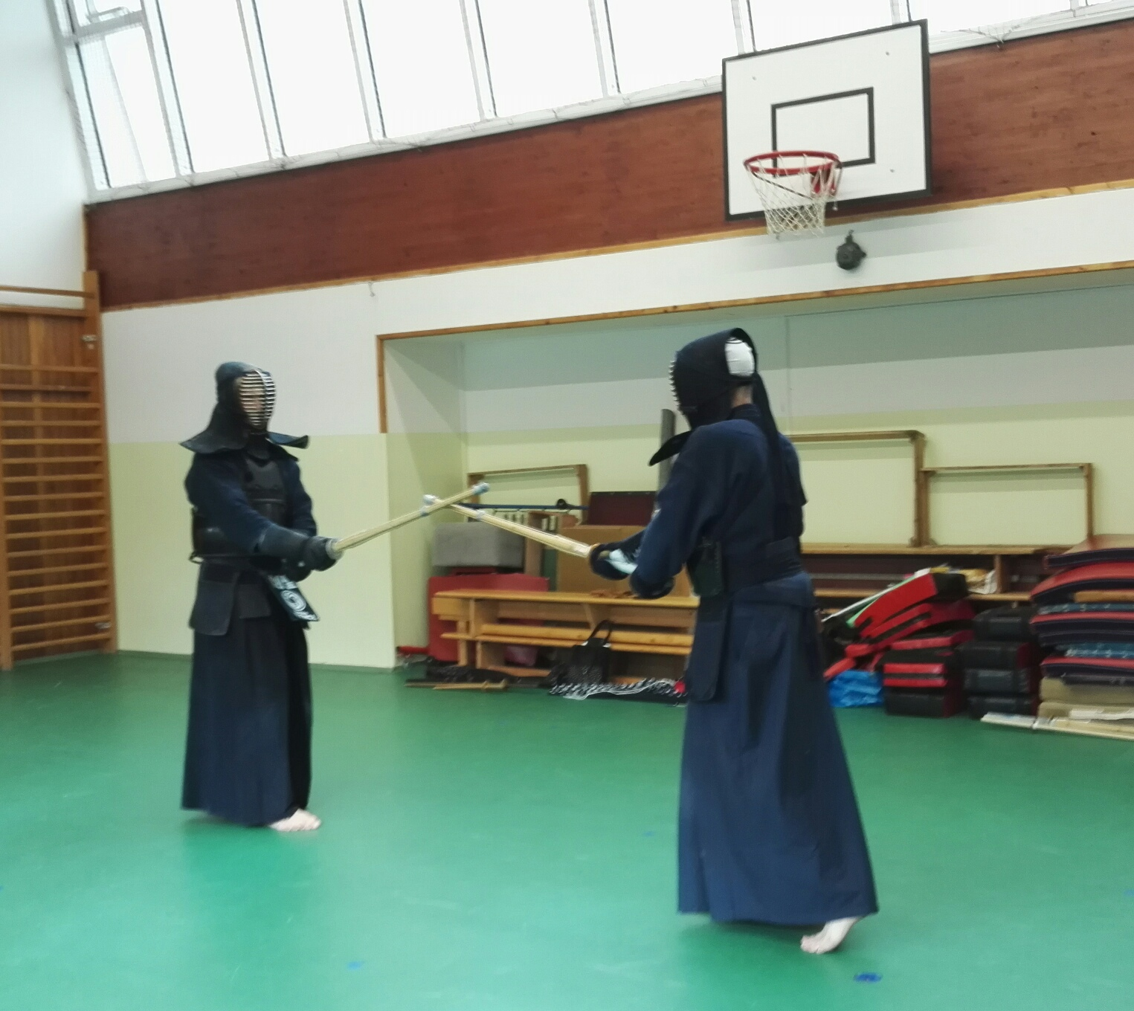
Elementary School K Dolům

Slide 23
Střední průmyslová škola dopravní
https://www.sps-dopravni.cz/
The school was founded more than 60 years ago and has a long tradition of high-quality teaching in technical fields.
Their methods are based on traditional methods and are continuously developing to include modern trends of theoretical teaching and hands-on learning in the workplace.
The practical training program takes place mainly in the last year of study in collaboration with Prague Public Transit Co., Inc. or in approved garages.
Consequently our students are able to gain valuable work experience during their studies. This experience would not be possible without the school curriculum and the close cooperation of qualified teachers and specialists from the field.

Slide 24
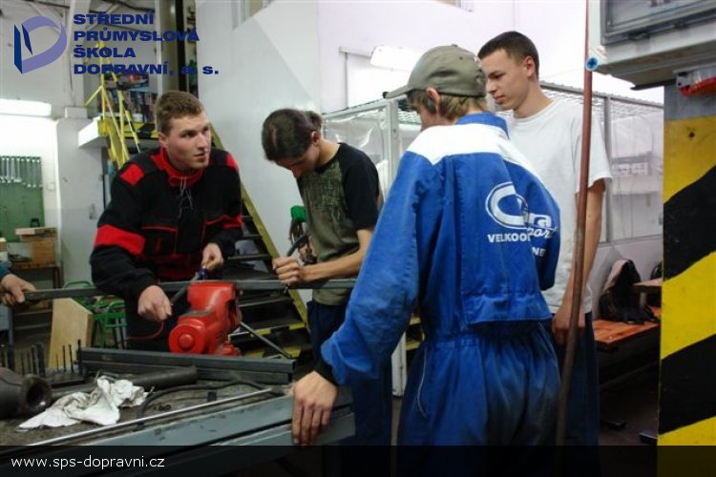
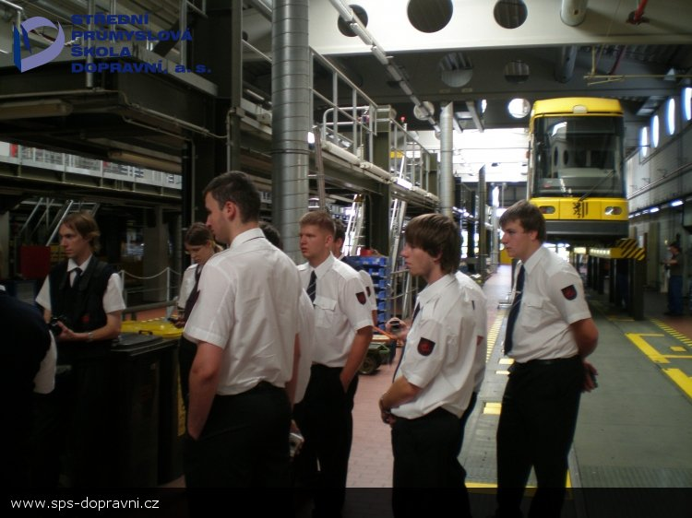

Slide 25
Elementary school and kindergarten Grafická
https://www.zsgraficka.cz/zakladni-skola
Elementary school and kindergarten Grafická is an inclusive and multicultural school, visited by children of different nationalities, pupils from bilingual families, gifted children, and also children with special needs, such as disabilities or autism.
In cooperation with parents and other professionals, the school creates individual educational programs for each child.
Specialized pedagogues, teaching assistant, psychologist or speech therapist are available for children with special needs. In the afternoon pupils can for free attend tutoring.
The school also has IT classroom, interactive whiteboards, tablets.

Slide 26
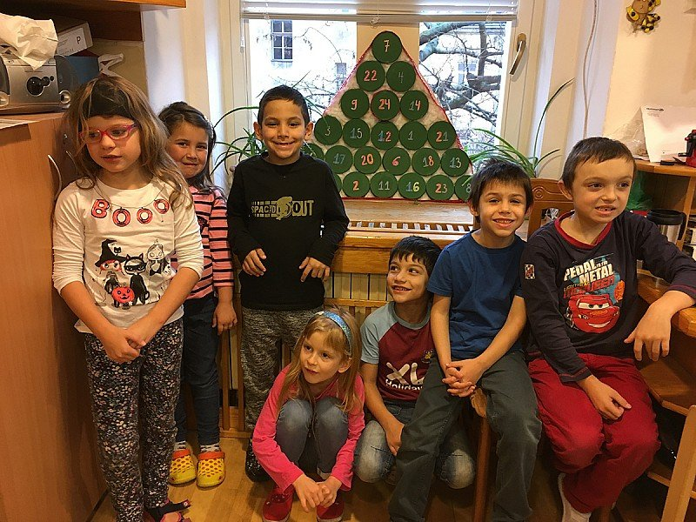
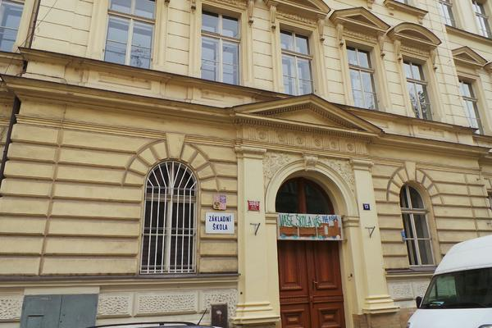

Slide 27
Theoretical lessons
introduction of ICT in schools - politics in this topic
general using of ICT and multimedia in education, ICT plans
teamwork in electronic documents
interactive tables, computers, tablets and its usage
education of employers through ICT
internet educational programmes, information system used at schools
acquaintance with new technologies, e-learning training systems and methodologies of making online courses
safety on the internet, copyright law
using computers and other technologies in children's free time

Slide 28
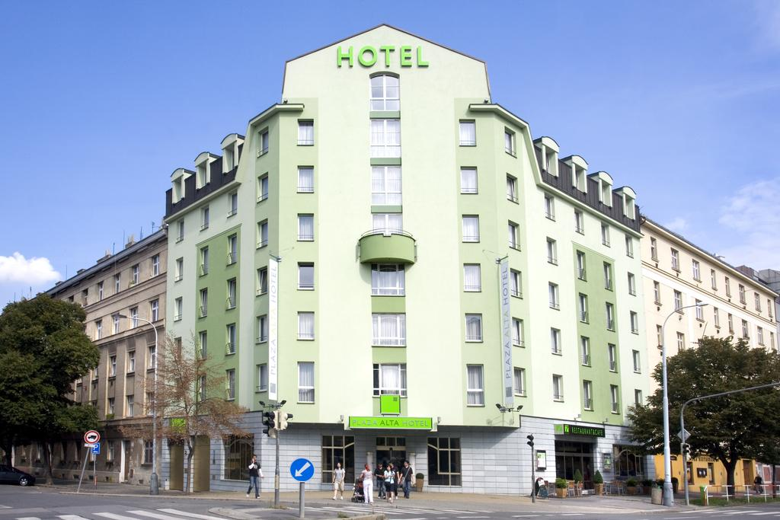
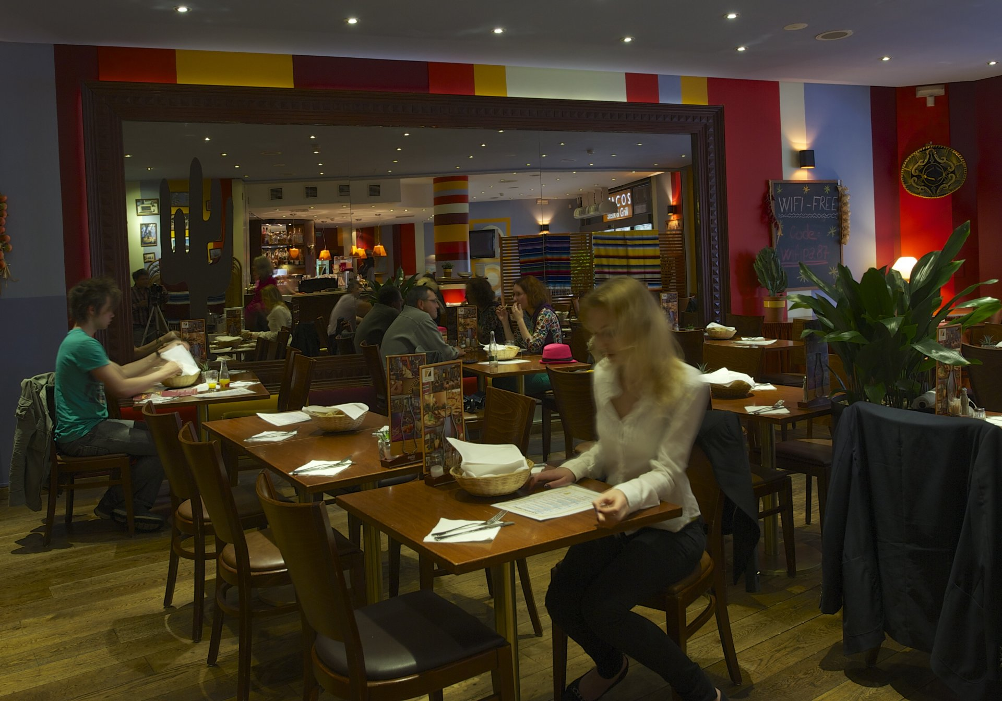
Accommodation
Plaza Alta Hotel
Modern, peaceful and eco-friendly. This four-star hotel is the holder of the prestigious Ecolabel of the European Union. In quiet and green surroundings, ten minutes from Prague city centre with easy access by public transport, free Wi-Fi and delicious Mexican restaurant.

Slide 29
Thank you for your attention.
Katerina Grecova
katerina.grecova@eracr.cz
phone: 00420 779 970 906
private phone: 00420 721 445 346

